Slide 1
Genetics

Slide 2
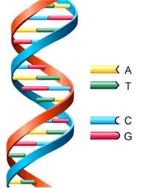
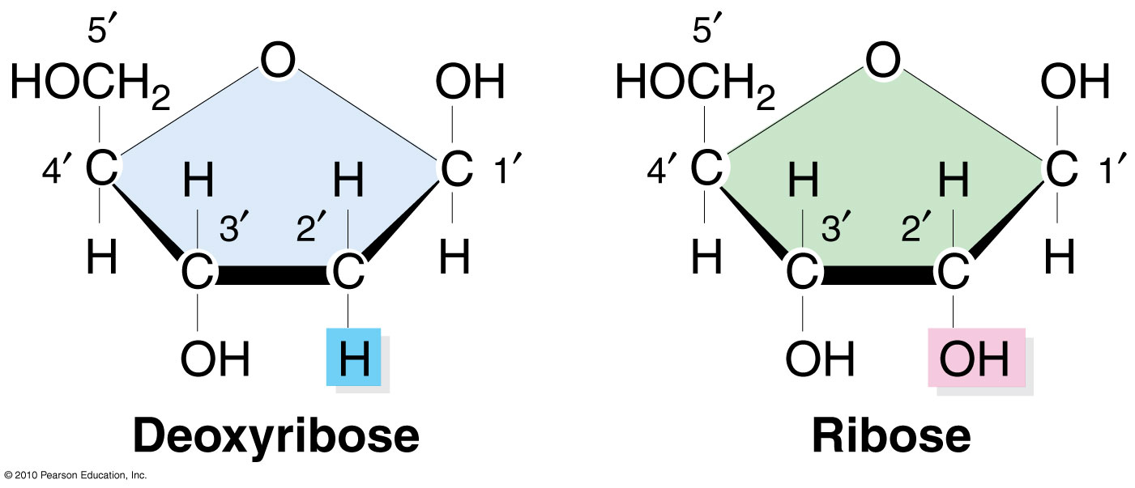
DNA
DNA is a polymer, chain of connect nucleotide.
Each nucleotide consists of nitrogenous base, sugar, and phosphate
No oxygen on 2’ carbon
5’ exocyclic
RNA
Oxygen on 2’ carbon
Pyrimidine (1 RING)
Thymine, uracil
Purine (2 Ring)
Adenine and guanine

Slide 3
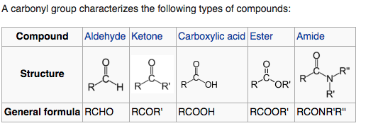
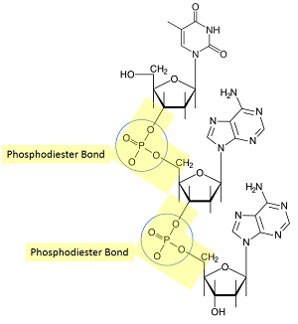
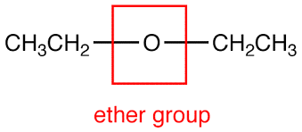
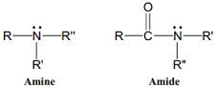
Functional Groups
dadf

Slide 4
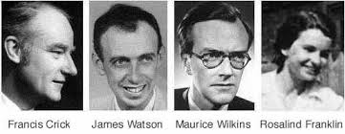
PEOPLE
Chargraff’s Rule
Adenine and thymine are roughly consistent; as with cytosine and guanine
Roselyn Franklin
Xray diffraction and got measurements of picture
Watson and Crick
Their models agreed with Chargaff, Franklin’s measurements, bonds and chemistry
DNA->RNA-> Protein

Slide 5
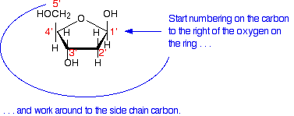
BONDING
Adenine and thymine – 2 bonds
BECAUSE no partial positive because hydrogen has no charge on adenine
Cytosine and guanine – 3 bonds
Antiparallel- 5’ to 3’ are opposite in two strands
Protein binds in the grooves
because that’s where the
bases are.

Slide 6
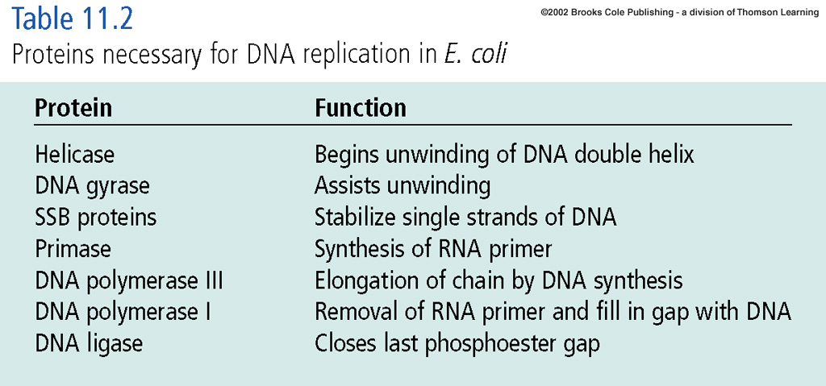
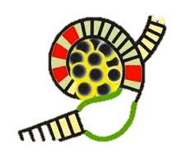
Replication
Starts: Origin of replication
DNA A box: binding site recognized by DNA binding protein DNAa
AT rich region- easily meltable
DNAa binding proteins cause the AT rich region to open up

Slide 7
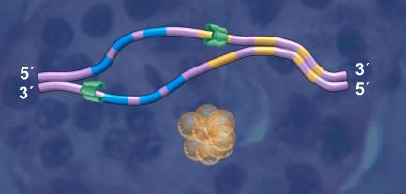
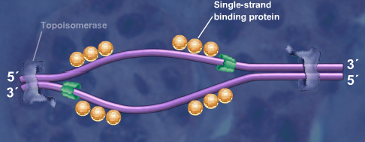

Replication
SSBP stabilizes bubble
Topoisomerase relieves supercoiling of DNA by unwinding strands.
Type 1 breaks in phosphodiester bond
Broken strand now rotates around attached strand
Type 2 reforms bond
Reforms phosphodiester bond breaks bond in both strands
Helicase opens up bubble even further.

Slide 8
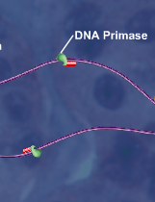
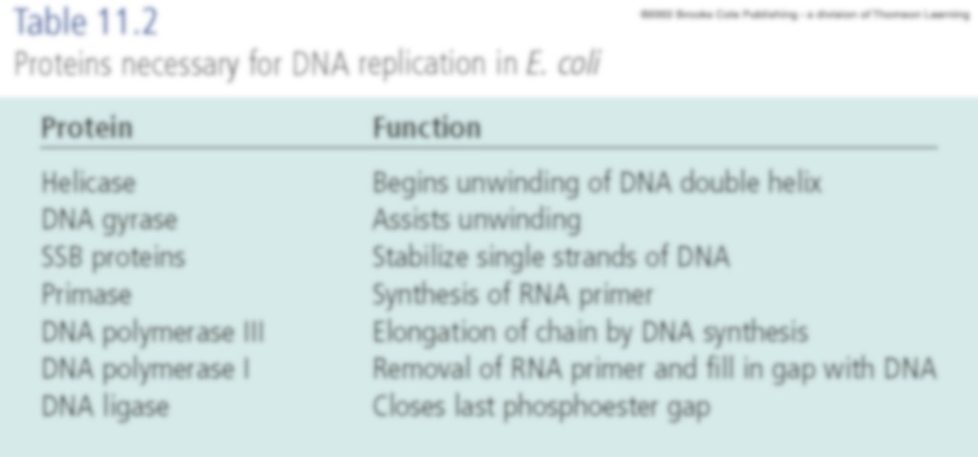
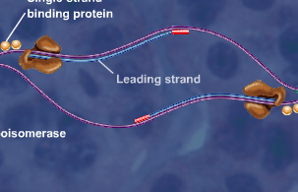
Replication
DNA Primase, enzyme (to fork)
Synthesizes rna primer
DNA polymerase elongates primer
DNA Polymerase III extends primer from 5’ to 3’ ( to fork)
5
3
3
5

Slide 9
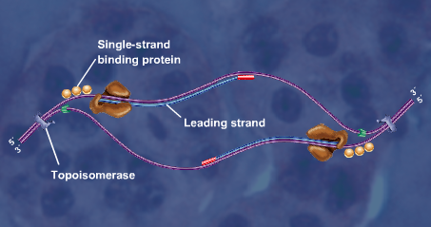
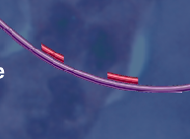
Replication
The white dash is the lagging strand
Made away from the replication fork
DNA Primase makes the short RNA primers (red)
DNA polymerase then extends these Okizaki fragments (5->3)
DNA polymerase I removes primers and fills vacant region
Ligase connects them

Slide 10
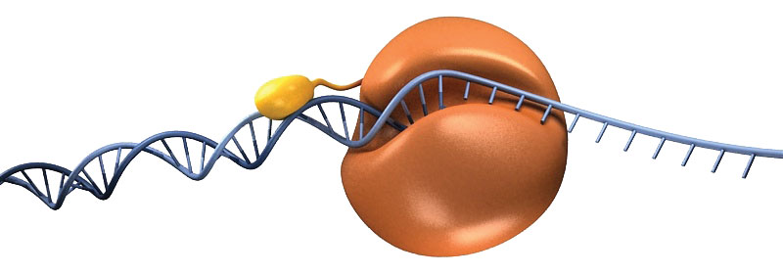
Replication
DNA Polymerase adds nucleotides via phosphodiester bonds.
Energy for this process comes from hydrolysis of phosphate of three phosphates attached the base.
This is because this reaction is unfavorable
DNA polymerase alpha -
5-3’ RNA polymerase activity
Initiate new strand
low processivity
doesn’t get very far before it dissociates
it doesn’t actually make enough DNA 5-3 DNA polymerase activity

Slide 11
Replication
DNA Polymerase III
DNA CLAMP
Protein fold that address low processivity of alpha
When alpha disassociates, it is bound to clamp and will reassociate
Extend more because of protein and protein interactions (800 ncltis/sec)
3’ to 5’ exonuclease activity
DNA Polymerase I
Can move backwards one base pair
3’ to 5’ exonuclease activity can proofread
i.e. Distortion between purine and pyrimidine
low processivity
5’ to 3’ activity to remove primers
Cannot proofread and remove primer simultaneously

Slide 12
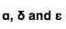
Replication
Epsilon and Delta are similar they replace each other
Epsilon
Binds where alpha leaves off
Continues strand continuously on leading strand
Delta
Negative does not initiate on lagging strand because no rna polymerase but it continues it
High processivity, perfect for newer okizaki
Adds nucleotides from 5-3’
proofreads
Alpha
Initiates lagging strand
Rna then dna then dissociates

Slide 13
Replication
FEN 1
has 5’ to 3’ exonuclease activity
older okizaki fragments
cannot make DNA and proofread
removes primer and DNA by pol alpha
removes nucleotide off 5’ end
Delta (okizaki, proofreads, 5 to 3)
one phosphodiester bond -----------------()-------------- between okizaki
ligase does the last bonding of okizaki fragments
clamp

Slide 14
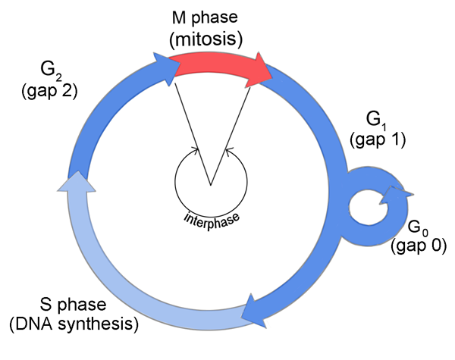
Replication
The key replication enzymes at the replisome are helicase, primase, and polymerase III.
Wound healing requires mitosis
Mitosis slows as you get older
Non replicating cells are in a stage called Go
When replisome reaches the end of DNA
Lagging strand is incomplete=>yielding shorter DNA molecules
Uses telomeres
Telomerase (TTAGGG)
Rich in T & G
Protein & rna components (RNA template)
Add to 3’ nucleotide telemore complementary to its own Rna component
No coding “junk dna”.

Slide 15
Replication
Germ cells divide to create gametes
Diploid cells in testes and eggs to make gametes
Small percentage have telomerase
Cancer Cells
90% have telomerase
Mutations go down then to be expressed again
Telomerase makes room for okizaki fragments
Not needed for prokaryotic because its circular
Limitations in somatic cells

Slide 16
Replication
Theta replication in bacteria
One origin of replication
Bidirectional
NO nuclear membrane in prokaryote
Bacteria is critical for labwork and is everywwhere
ALSO mitochondia is weird replication bc slower and less DNA
Eukaryotes have multiple origins, makes it faster bc we have so much more dna
Θ

Slide 17
TRANSCRIPTION

Slide 18
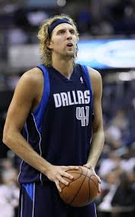
Transcription
DNA-> RNA
MAJOR PLAYER
RNA polymerase
Reverse transcription
Rna can be used as a template to make dna
Makes negative copy of rna (DNA) and then use it to make rna copies
i.e. retroviruses like hiv
Capacity to be transcribed makes a gene (has regulatory sequences)

Slide 19
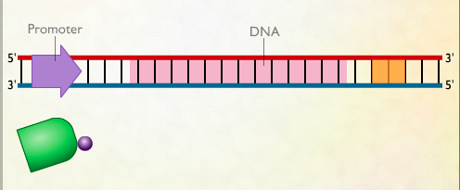
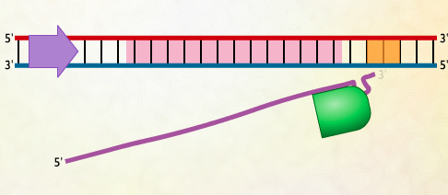
Transcription
RNA polymerase along with sigma factor bond to promoter region.
Sigma factor (subunit of mRNA) dissociates
RNA polymerase synthesizes 5’3 for mRNA along template strand
Antiparallel and complementary
Transcription terminator causes a hairpin structure in mrna causing it to dissociate along with polymerase from the DNA
One product is also tRNA (transport)

Slide 20
Transcription
Promoter
Next to the gene is this cluster of sequences
HAS THREE FUNCTIONS
1. Binding
RNA polymerase binding to the promoter
2. DNA must unwind in the promoter
Open the complex
3. Marking the exact nucleotide where transcription will begin

Slide 21
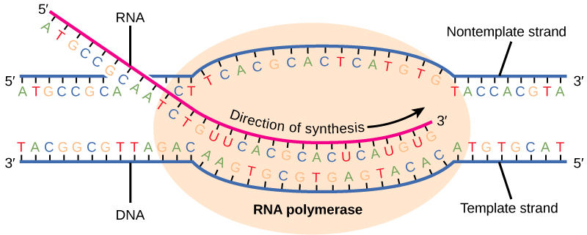
Transcription
Transcription elongation
No primer
No proofreading
Sequence at the end of gene to cause
You use the template for RNA
BUT you can just look at the sense strand of DNA and switch thymine and uracil
5 to 3 because energy requirement
For a given gene

Slide 22
Transcription
Transcription bubble is relatively small (20 nucleotides in length)
RNA Polymerase moves downstream (+1 +2 +3) while upstream is (-1 -2 -3)
Numbering works with gene level not chromosomal
When transcription rate drops significantly, you found the promoter!!

Slide 23
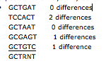
Transcription
Genes sequences that are remarkably similar are conserved
Conserved sequence
Implies=> function
Consensus Sequence
R or Pu= Purine
Y or Py= Pyrmidine
N= any nucleotide goes
Bias to shape or particular nucleotide
More similar its up mutation

Slide 24
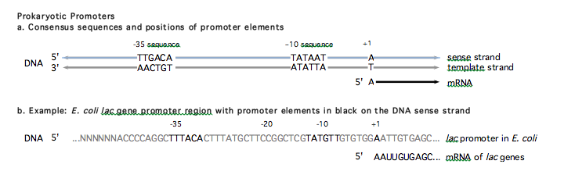
Transcription
PROKAROTIC TRANSCRIPTION!
Idealized promoter
Shows conserved sequences represented by consensus sequence
Promoter must fulfill same 3 functions
We can test the sequences by mutating the nucleotides to figure out the function of conserved sequence
-35 sequence and -10 sequence somehow takes a role in binding
-10 being unwinding because AT rich (2 bonds meltable)

Slide 25
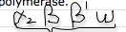
Transcription
PROKAROTIC TRANSCRIPTION!
There is a DNA binding domain in RNA polymerase
RNA polymerase core enzyme
Helicase activity, 5 to 3 prime activity, bind dna but not specifically, it can not find promoter
Bc polymerase is stationary on sigma subunit it frees cores enzyme placing it in motion
RNA polymerase holoenzyme
Necessary for initation
Sigma is only for -35 sequence (starts)
Helicase is over -10, geography has to line up for polymerase
+1 transcription start point

Slide 26
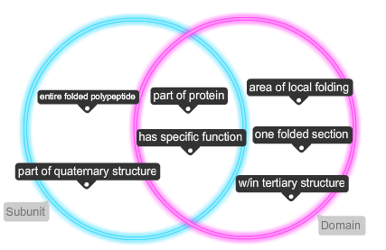
Transcription

Slide 27
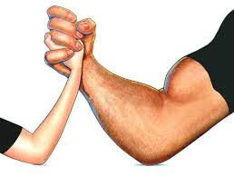
Transcription
Weak Promoters
Lacks help from regulatory proteins
You can tell by looking at difference between conserved vs consensus
Weak proteins exist because of regulation
No need for enzyme
Strong Promoters
High transcription rate
Perfect match
Gene product is NEEDED
Some shitty some perfect because of regulation
Promoters don’t change based on environment

Slide 28
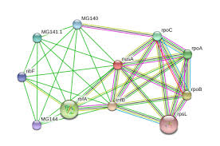
Transcription
NusA protein
Only in prokaryotes because transcription and translation is coupled
Not part of initiation ☹ BUT ☺ for elongation and termination
Binds in place instead of sigma factor
It SLOWS DOWN RNA POLYMERASE (wtf!!!)
Since ribosome is bound onto RNA farther upstream closer to 5’ end can translate
Otherwise rpase will zoom ahead

Slide 29
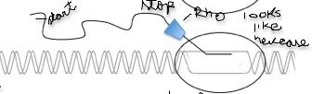
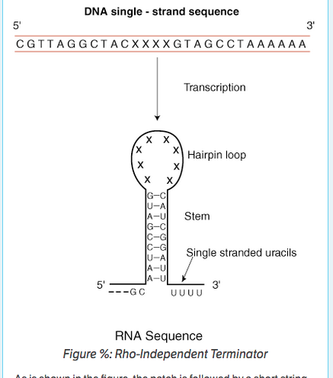
Transcription
Termination in prokaryotes
Rho dependent
Based on the protein, rho factor
Bind at the end of the rna chain and slide along strand to bubble and then catches polymerase and pulls it off dna strand
Viruses, phage
Rho independent
More simple termination
Region that contains a section then repeated invertedly after the hairpin loop
Most prokaryotes

Slide 30
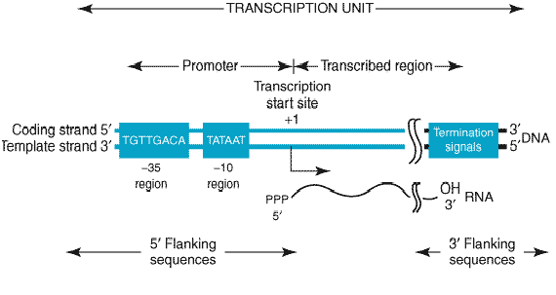
Transcription
Initiation, elongation, termination
TATA box at -25
Unwinding begins
Sigma factor does not exist
More specific about spacing
RNA polymerase binds at the promoter through transcription factors.
For marking transcription, location is not as specific for prokaryotes
+1 is transcript origination using adenosine tri phosphate

Slide 31
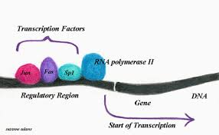
Transcription
RNA polymerase I- transcribes rRNA genes mean 5S’ rRNA
RNA polymerase II- transcribes mRNAs/proofreads genes
Transcription complex: TFIID, TFIIA, TFIIB
Tf- transcription factor
II- matches up with rna polymerase II
Each factor has its own letter designation
RNA polymerase III- “small RNAS” i.e. tRNAs, 5S’ r RNA
Transcription factor: TFIIIA, TFIIIB, TFIIIC

Slide 32
RNA Processing

Slide 33
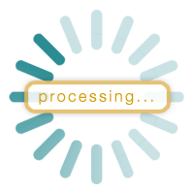
RNA Processing
What is RNA processing?
The modifications made to RNA after they are transcribed (post transcriptional modification)
1. Helps RNA to be recognized for translation
2.increase efficiency of protein synthesis by choosing which rna translates
Prokaryotes
mRNA ready to translate to protein
Eukaryotes
mRNA not immediately ready for translation

Slide 34
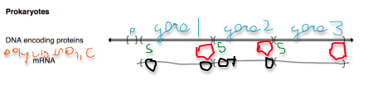
RNA Processing
Prokaryotes (polycistron) | Eukaryotes (monocistron)
mRNA- identical to transcript (no post transcription factors) ---------------------------------------- tRNA and rRNA post transcritionally modified via cleavage through ribonuclease. --------------------------------------- tRNA further modifed to give species its unique identity --------------------------------------- rRNA generated from pre- rRNA (cleaved via RNAse then trimmed through exonuclease) 30 50 70 5 23 16 | mRNA- extensive modification co/postranscriptionally --------------------------------------- // --------------------------------------- // Internal promoter (diff RNA polym) --------------------------------------- rRNA(23S, 16S, 5.8S) One promoter because equal molar amount 80 60 40 5.8 18 ---------------------------------------

Slide 35
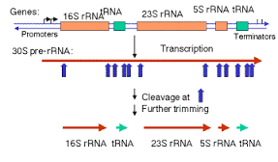
RNA Processing
Endonuclease cleavage (via ribonucleases/ RNases)
Exonuclease trimming
RNA editing (changing of RNA sequence after transcription)
Onsite conversion
are location specific
tRNAs (further modified)

Slide 36
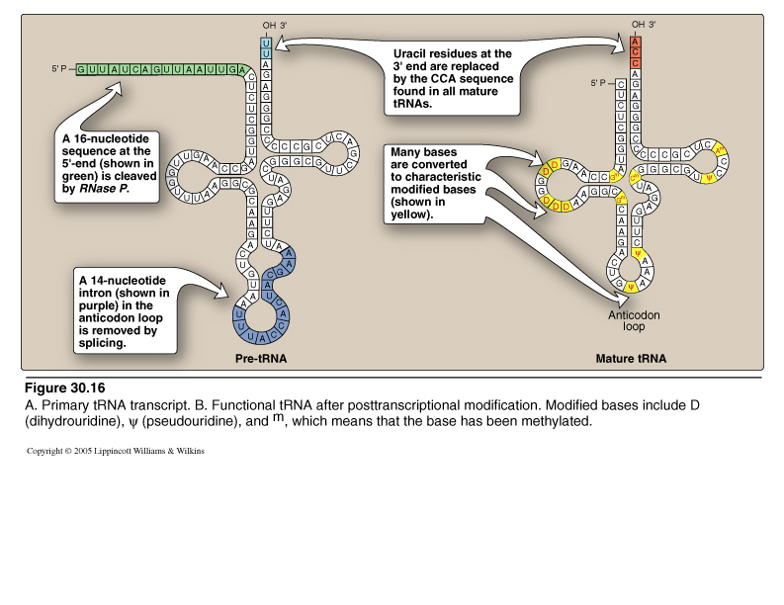
RNA Processing
tRNA Editing
thymine is a rare base
Modified bases:
Pseudouracil Ψ
Uracil=>(m) Thymine (adding a methyl group)
Uracil=>(D) Dihybrid Uracil (converting the base)
The change is so the right enzyme can recognize it.
increase in speed or increase in translation Anticodon change
Only tRNAs are edit because rare bases are 10 percent of sequence
Intron removed from anticodon loop by nuclease

Slide 37
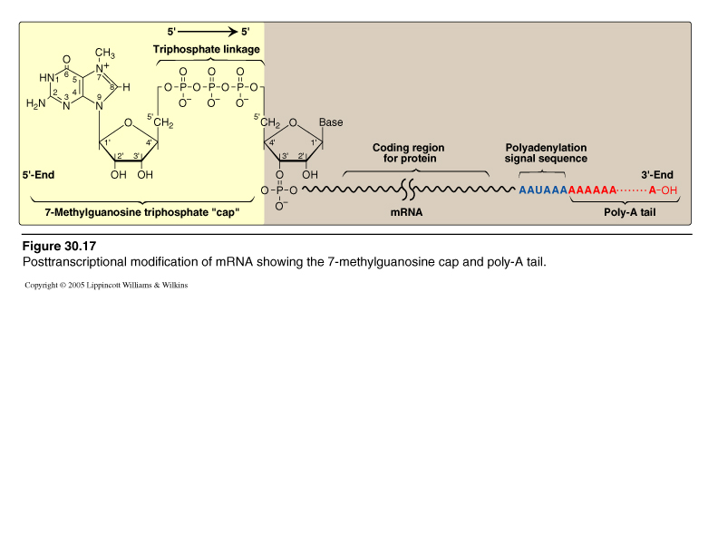
RNA Processing
Eukaryotes
Pre mRNA
Splicing with a 5’ G cap and 3’ poly a tail
After mRNA enters cytosol it gets shortened so it stabilizes and facilitates its exist and aids in translation
Remove intron (splicing)
Does it via spliceosome snRNAs u1 u2 u4 u5 u6 (transcript intron combines with snRNPs)
Alternate splicing
Diverse set of proteins from small set of genes

Slide 38
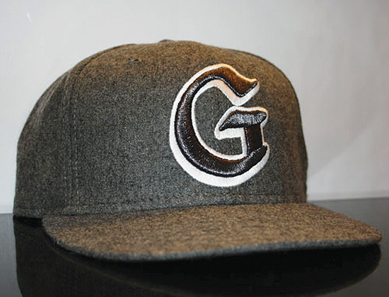
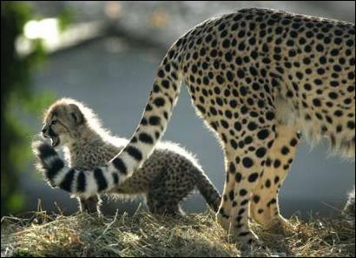
RNA Processing
5’ G Cap Purpose
Binding site for ribosome in cytoplasm
Cap attached in the nucleus
Protects the 5’ end of eukaryotic mRNA
RNAse breaks down because exonuclease degradation (prokaryote isnt protected) (eukaryote is now 5’ to 5’ instead of 3’ to 5’)
Poly A tail (conserved sequence after stop)
AAUAAA- polyadenlation signal BINDING SITE
Endonuclease cleavage breaks phosphodiester bond from transcription
polyA polymerase builds tail no template only picks up adenosine (adenine, ribose, phosphate) long enough to get translated
polyA binding protein will bind at end of tail prevents access of exonuclease slow degradation (isnt best bc gene expression at any time)

Slide 39
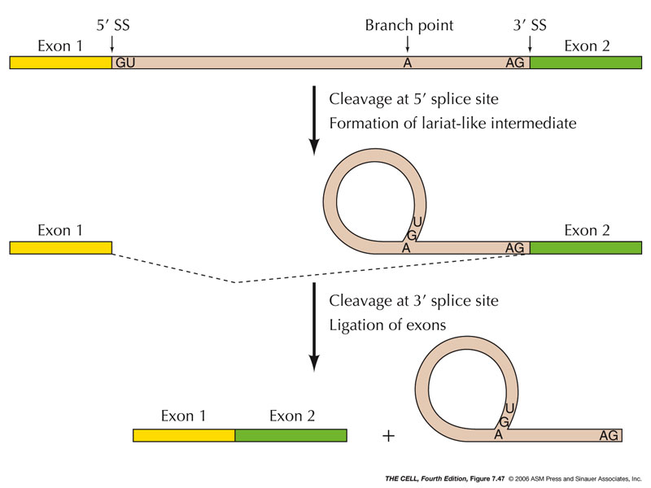
RNA Processing
SPLICING (in nucleus)
Branch point: YNYYRAY (a is 100% conserved in eukaryotes)
Regulatory sequence is next to branch point for regulatory protein
snRNP U1 recognizes 5’ splice site*
snRNP U2 recognizes and binds to branch point
bending,+spliceosome complete
Bond of G and A is 5’ to 2’ forming lariat
2’ because of phosphodiester bond and there is a hydroxyl
Spliceosome end
Cut at 3’ end releasing lariat
Connects exons

Slide 40
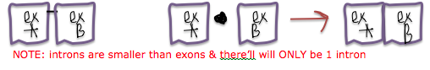
RNA Processing
Bacterial Splicing
Introns will fold on itself (secondary and tertiary) (multiple stem loop)
For lower energy state and to gain function
Brings exons closer
Can splice itself out and join exons via phosphodiester bond (catalytic function)
Ribozyme is an RNA with catalytic activity

Slide 41
Translation

Slide 42
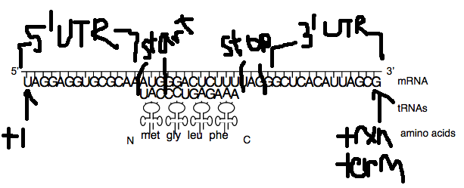
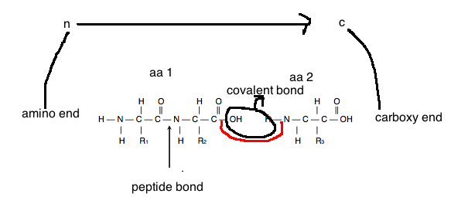
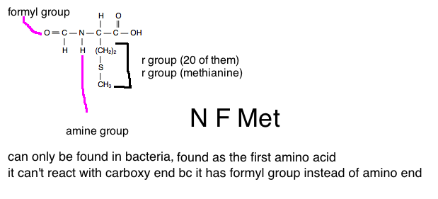
Translation
Where does it start?
The untranslated region (UTR)
Start codon
Starts the reading frame
Each codon specifies a specific tRNA
Can not carry an amino acid
Arranged in a specific order by bonds of ribosome
Amino acids have same polarity
Added on carboxyl end via dehydration synthesis
N f met is an exception only in bacteria its first

Slide 43
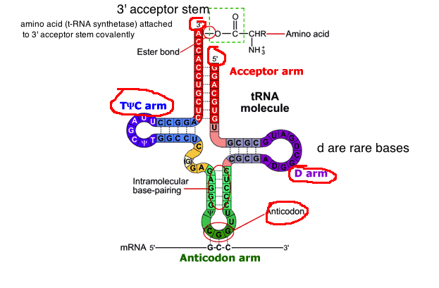
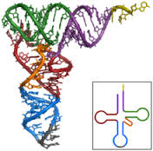
Translation
tRNA clover secondary function
Boomerang jumble tertiary function
Rare bases affect shape of tRNA
TψC arm- has modified uridine
D arm- has dihybrouradine
Anticodon arm- anticodon in reverse order
3’ longer has amino acid trRNA synthetase
5’ phosphate group

Slide 44
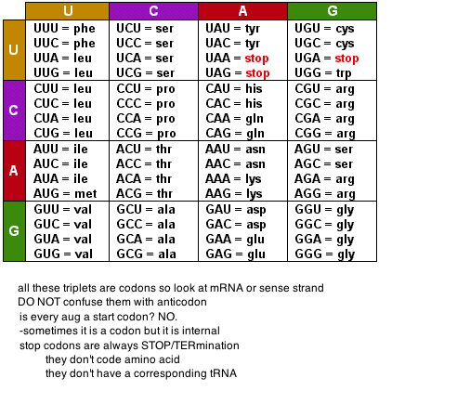
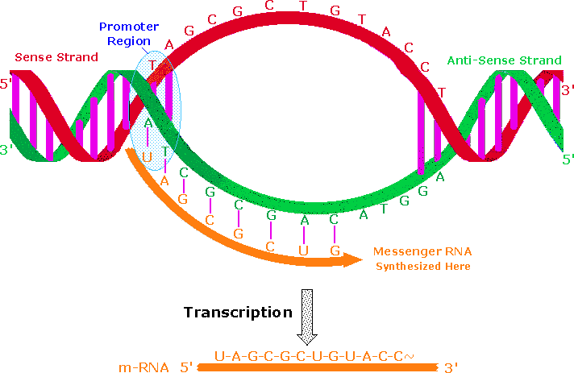
Translation
Anticodon on trna
Codon on mRNA
Look at sense strands/mRNA
Read from 5’ to 3’
Universal code
Striking that bacteria can make human polypeptide
Protists and mitochondria are the fucker exceptions (spots of difference)
Degenerate
Redundant but not ambiguous
Looks different doesn’t mean its different
Codon is explicit
64 codons, 3 stop, 61 amino acid encoding codons

Slide 45




Translation
WOBBLE RULES
tRNA and mRNA not lined up because opposite partial charges are aligned weird
IC IU IA GU

Slide 46

Translation
Ribosomes are protein builders made of proteins. A rudimentary ribosome came before protein.
RNA body
2/3 rna mass
Proteins small and stabilize and incrase speed and accuracy in translation
Shape from rna folding

Slide 47

Translation
Shine dalgarono Kozak sequence 40 S
N f met methionine
IF EF RF eIFs eEfs eRFS
30s +50s=>70S 40S+60S=>
16S base pair to SD 40S binds to 5’ cap

Slide 48

Translation
Beadle and Tatum
Genotype->Enzyme->steps in biochemical pathway (metabolism)->phenotypes
One gene one enzyme
Garrod (genotype->metabolism->pheno)
Genetic diseases are inborn errors of metabolism
Block in the pathway (PKU)
Lack of product (malnutrition) OR too much of substrate (neurological disorder)
alkaptonuria (black urine)
The real problem with black urine disease is not the urine it is the joint pain.
homogentisic acid excretes black

Slide 49
Translation
Beadle and Tatum “one gene one enzyme”
Alternative splicing- one gene encodes multiple peptides
Multisubunit proteins include products of different genes
Hemoglobin heterotetromer, different subunit products of different genes
Proteins that aren’t enzyme
Genes that are non encoding RNAs (tRNA, snRNA, etc)
One gene one polypeptide
Solves proteins that aren’t enzymes
Solves multi subunit protein products of different genes
Did not solve alternate splicing or non encoding RNAs
One gene encodes one or more polypeptide or non encoding RNA

Slide 50



Translation
Initiation
IF binds to Shine Dalgarno
If1 (a site) +if3 on 16s 30s subunit
If2 on GTP with n f met
GTP=>GDP, trna shape change
Allowing 50S to bind (if binds and dissociates)
Elongation
P site- peptidyl site
A site- amino acyl site
Cycle- series of steps then steps repeated
Diffusion Ef-TU
Translocation-EF-G GTP cleaves GTP to move ribosome
Termination
Release factors
RF1- molecular mimicry of tRNA recognizes stop codon
RF3- takes place of IF2, helps subunit repel and come apart
Post Translational Modifications
1. removal of 1 or more aa (met) from the amino end
2. Addition of non protein compounds (i.e. carbohydrates cant be translated)
3. removal of interior stretches- protein splicing

Slide 51
Mutation

Slide 52

Mutation
What is a mutation?
A heritable change in the genetic material
Heritable change is copyable changes in new strand
Genetic material is DNA but can be RNA aka viruses (not for us)
What is a point mutation?
Alteration in one nucleotide or one base pair in the genetic material
Substitutio ALWAYS
Transition puRine or pYramdine
Transvergence R<->Y
Deletion + Insertion can be point

Slide 53

Mutation
Mutation in a chomosomal level
Inversion
Translocation
Problems happen during meisois via crossing over
You only see mutations after replication
3 billion base pairs in each ploid

Slide 54

Mutation
Same sense mutation
changes a codon encoding an amino acid into a codon encoding the same amino acid
No effect on function
Mis sense mutation
Changes a codon encoding an amino acid into a codon encoding a different amino acid
May have no effect, may render it unfunctional (based on similar different properties, location based on its function)
Non sense mutation
Codon with an amino acid into a stop codon
nonfunctional
Reading frame changes when not a multiple of three, it is in the intron, or in the untranslated region because has to be part of reading frame. (may affect protein not reading frame)

Slide 55
Mutation
Mutant sequence- rare and nonfunctional
Wild type- common and functional
TCG (ser) -> TAG (stop)
Forward sequence
Wild type to mutant sequence
TAG (stop) ->TCG (ser)
TAG(stop)->TGG (trp)
Reversion
Mutant sequence to wild type
Reversion is proofreading
Happens all the time in bacteria

